Slide 1
CS 325 - MST

Slide 2
Minimum Spanning Trees

Slide 3
Minimum Spanning Tree
Problem: given a connected, undirected, weighted graph:
6
4
5
9
14
2
10
15
3
8

Slide 4
Minimum Spanning Tree
Problem: given a connected, undirected, weighted graph, find a spanning tree using edges that minimize the total weight
6
4
5
9
14
2
10
15
3
8

Slide 5
Minimum Spanning Tree
Which edges form the minimum spanning tree (MST) of the below graph?
A
6
4
H
5
B
9
C
14
2
10
G
E
15
D
3
8
F

Slide 6
Minimum Spanning Tree
Answer:
A
6
4
H
5
B
9
C
14
2
10
G
E
15
D
3
8
F

Slide 7
Minimum Spanning Tree (MST)
A minimum spanning tree is a subgraph of an undirected weighted graph G, such that
it is a tree (i.e., it is acyclic)
it covers all the vertices V
contains |V| - 1 edges
the total cost associated with tree edges is the minimum among all possible spanning trees
not necessarily unique

Slide 8
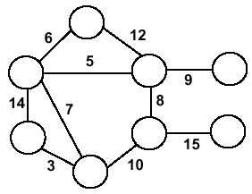
Minimum Spanning Trees
Undirected, connected graph G = (V,E)
Weight function W: E → R (assigning cost or length or other values to edges)
Spanning tree: tree that connects all the vertices Minimum spanning tree: tree that connects all the vertices and minimizes

Slide 9
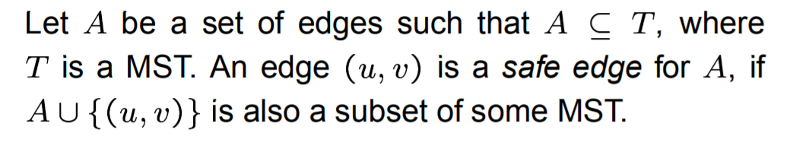
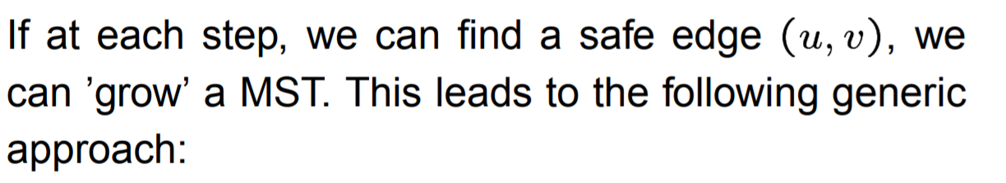
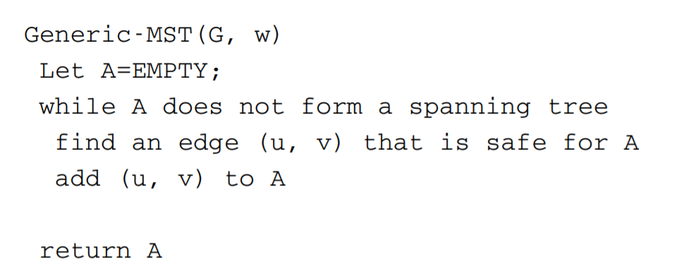
Generic Algorithm for MST

Slide 10
How to find a safe edge
We first give some definitions. Let G=(V,E) be a connected and undirected graph. We define:
Cut - A cut (S, V-S) of G is a partition of V.
Cross - An edge (u, v)∈ E crosses the cut (S, V-S) if one of its endpoints is in S, and the other is in V – S
Respect - A cut respects a set of edges if no edge in A crosses the cut.
Light edge - An edge is a light edge crossing a cut if its weight is the minimum of any edge crossing t

Slide 11
Lemma
Let G=(V,E) be a connected, undirected graph with a real-valued weight function w defined on E . Let A be a subset of E that is included in some minimum spanning tree for G , let (S, V-S) be any cut of G that respects A, and let (u,v) be a light edge crossing the cut (S, V-S). Then, edge (u,v) is safe for A.
We can find a safe edge by
first finding a cut that respects A ,
then finding the light edge crossing that cut.
That light edge is a safe edge.

Slide 12
Proof
Let A ⊆ T , where T is a MST. Suppose (u,v) ∉ T.
The trick is to construct another MST T’ that contains both A and (u,v) , thereby showing (u,v) is a safe edge for A.
Since u and v are on opposite sides of the cut (S, V-S) , there is at least one edge in T on the path from u to v that crosses the cut. Let (x,y) be such edge. Since the cut respects A , (x,y) ∉ A .
Since (u, v) is a light edge crossing the cut, we have
w(x,y) >= w(u,v)

Slide 13
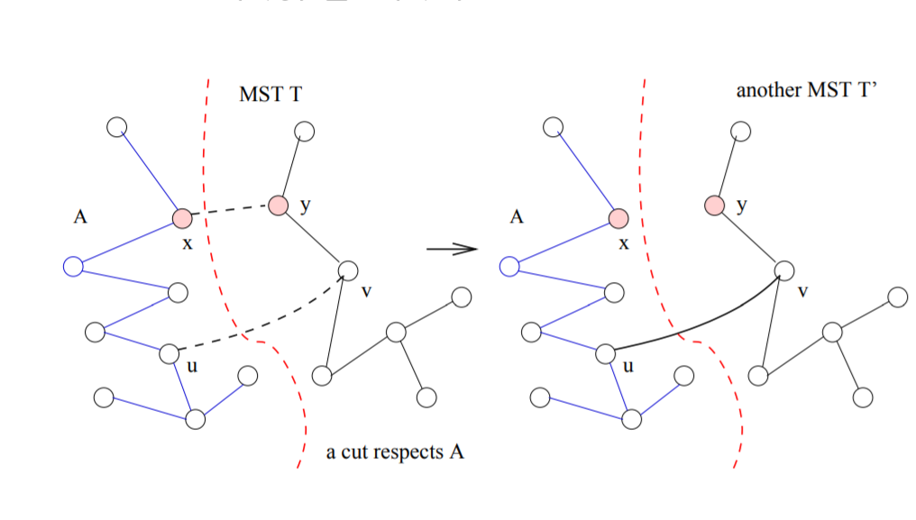

Slide 14
4. Add (u, v) to T , it creates a cycle. By removing an edge from the cycle, it becomes a tree again. In particular, we remove (x,y) to make a new tree T’ .
5. The weight of T’is
w(T’) = w(T) – w(x,y) + w(u,v)
<= w(T)
6. Since T is a MST, we must have w(T) = w(T’) , hence T’ is also a MST.
7. Since A ∪ {(u,v)} is also a subset of T’ (a MST) (u,v) is a safe edge for A.

Slide 15
Greedy Algorithms for Minimum Spanning Tree
[Prim] Extend a tree by including the cheapest out going edge
[Kruskal] Add the cheapest edge that joins disjoint components
4
b
c
20
5
11
8
a
d
7
22
e

Slide 16
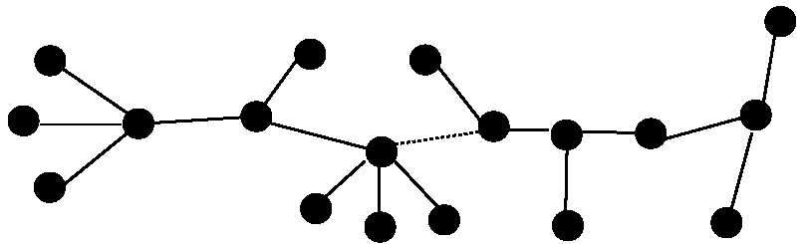
Optimal Substructure
T₂
MST T
Removing the edge (u,v) partitions T into T₁ and T₂
We claim that T₁ is the MST of G₁=(V₁,E₁), the subgraph of G induced by vertices in T₁
Also, T₂ is the MST of G₂
T₁

Slide 17
Prim’s Algorithm
Vertex based algorithm
Grows one tree T, one vertex at a time
A cloud covering the portion of T already computed
Label the vertices v outside the cloud with key[v] – the minimum weigth of an edge connecting v to a vertex in the cloud, key[v] = ∞, if no such edge exists

Slide 18
Prim’s Algorithm Invariant
A loop invariant is a condition that is true immediately before and immediately after each iteration of a loop.
At each step, we add the edge (u,v) s.t. the weight of (u,v) is minimum among all edges where u is in the tree and v is not in the tree
Each step maintains a minimum spanning tree of the vertices that have been included thus far
When all vertices have been included, we have a MST for the graph

Slide 19
Prim’s Algorithm
MST-Prim(G, w, r)
Q = V[G];
for each u ∈ Q
key[u] = ∞;
key[r] = 0;
p[r] = NULL;
while (Q not empty)
u = ExtractMin(Q);
for each v ∈ Adj[u]
if (v ∈ Q and w(u,v) < key[v])
p[v] = u;
key[v] = w(u,v);

Slide 20
Prim’s Algorithm
6
4
MST-Prim(G, w, r)
Q = V[G];
for each u ∈ Q
key[u] = ∞;
key[r] = 0;
p[r] = NULL;
while (Q not empty)
u = ExtractMin(Q);
for each v ∈ Adj[u]
if (v ∈ Q and w(u,v) < key[v])
p[v] = u;
key[v] = w(u,v);
5
9
14
2
10
15
3
8
Run on example graph

Slide 21
Prim’s Algorithm
6
∞
4
MST-Prim(G, w, r)
Q = V[G];
for each u ∈ Q
key[u] = ∞;
key[r] = 0;
p[r] = NULL;
while (Q not empty)
u = ExtractMin(Q);
for each v ∈ Adj[u]
if (v ∈ Q and w(u,v) < key[v])
p[v] = u;
key[v] = w(u,v);
5
9
∞
∞
∞
14
2
10
15
∞
∞
∞
3
∞
8
Run on example graph

Slide 22
Prim’s Algorithm
6
∞
4
MST-Prim(G, w, r)
Q = V[G];
for each u ∈ Q
key[u] = ∞;
key[r] = 0;
p[r] = NULL;
while (Q not empty)
u = ExtractMin(Q);
for each v ∈ Adj[u]
if (v ∈ Q and w(u,v) < key[v])
p[v] = u;
key[v] = w(u,v);
5
9
∞
∞
∞
14
2
10
15
r
0
∞
∞
3
∞
8
Pick a start vertex r

Slide 23
Prim’s Algorithm
6
∞
4
MST-Prim(G, w, r)
Q = V[G];
for each u ∈ Q
key[u] = ∞;
key[r] = 0;
p[r] = NULL;
while (Q not empty)
u = ExtractMin(Q);
for each v ∈ Adj[u]
if (v ∈ Q and w(u,v) < key[v])
p[v] = u;
key[v] = w(u,v);
5
9
∞
∞
∞
14
2
10
15
u
0
∞
∞
3
∞
8
Grey vertices have been removed from Q

Slide 24
Prim’s Algorithm
6
∞
4
MST-Prim(G, w, r)
Q = V[G];
for each u ∈ Q
key[u] = ∞;
key[r] = 0;
p[r] = NULL;
while (Q not empty)
u = ExtractMin(Q);
for each v ∈ Adj[u]
if (v ∈ Q and w(u,v) < key[v])
p[v] = u;
key[v] = w(u,v);
5
9
∞
∞
∞
14
2
10
15
u
0
∞
∞
3
3
8
v
Grey arrows indicate parent pointers

Slide 25
Prim’s Algorithm
v
6
∞
4
MST-Prim(G, w, r)
Q = V[G];
for each u ∈ Q
key[u] = ∞;
key[r] = 0;
p[r] = NULL;
while (Q not empty)
u = ExtractMin(Q);
for each v ∈ Adj[u]
if (v ∈ Q and w(u,v) < key[v])
p[v] = u;
key[v] = w(u,v);
5
9
14
∞
∞
14
2
10
15
u
0
∞
∞
3
3
8

Slide 26
Prim’s Algorithm
6
∞
4
MST-Prim(G, w, r)
Q = V[G];
for each u ∈ Q
key[u] = ∞;
key[r] = 0;
p[r] = NULL;
while (Q not empty)
u = ExtractMin(Q);
for each v ∈ Adj[u]
if (v ∈ Q and w(u,v) < key[v])
p[v] = u;
key[v] = w(u,v);
5
9
14
∞
∞
14
2
10
15
0
∞
∞
3
3
8
u

Slide 27
Prim’s Algorithm
6
∞
4
MST-Prim(G, w, r)
Q = V[G];
for each u ∈ Q
key[u] = ∞;
key[r] = 0;
p[r] = NULL;
while (Q not empty)
u = ExtractMin(Q);
for each v ∈ Adj[u]
if (v ∈ Q and w(u,v) < key[v])
p[v] = u;
key[v] = w(u,v);
5
9
14
∞
∞
14
2
10
15
0
8
∞
3
3
8
v
u

Slide 28
Prim’s Algorithm
v
6
∞
4
MST-Prim(G, w, r)
Q = V[G];
for each u ∈ Q
key[u] = ∞;
key[r] = 0;
p[r] = NULL;
while (Q not empty)
u = ExtractMin(Q);
for each v ∈ Adj[u]
if (v ∈ Q and w(u,v) < key[v])
p[v] = u;
key[v] = w(u,v);
5
9
10
∞
∞
14
2
10
15
0
8
∞
3
3
8
u

Slide 29
Prim’s Algorithm
6
∞
4
MST-Prim(G, w, r)
Q = V[G];
for each u ∈ Q
key[u] = ∞;
key[r] = 0;
p[r] = NULL;
while (Q not empty)
u = ExtractMin(Q);
for each v ∈ Adj[u]
if (v ∈ Q and w(u,v) < key[v])
p[v] = u;
key[v] = w(u,v);
5
9
10
∞
∞
14
2
10
15
0
8
∞
3
3
8
u

Slide 30
Prim’s Algorithm
6
∞
4
v
MST-Prim(G, w, r)
Q = V[G];
for each u ∈ Q
key[u] = ∞;
key[r] = 0;
p[r] = NULL;
while (Q not empty)
u = ExtractMin(Q);
for each v ∈ Adj[u]
if (v ∈ Q and w(u,v) < key[v])
p[v] = u;
key[v] = w(u,v);
5
9
10
2
∞
14
2
10
15
0
8
∞
3
3
8
u

Slide 31
Prim’s Algorithm
6
∞
4
MST-Prim(G, w, r)
Q = V[G];
for each u ∈ Q
key[u] = ∞;
key[r] = 0;
p[r] = NULL;
while (Q not empty)
u = ExtractMin(Q);
for each v ∈ Adj[u]
if (v ∈ Q and w(u,v) < key[v])
p[v] = u;
key[v] = w(u,v);
5
9
10
2
∞
14
2
10
15
0
8
15
3
8
v
3
u

Slide 32
Prim’s Algorithm
∞
u
6
4
MST-Prim(G, w, r)
Q = V[G];
for each u ∈ Q
key[u] = ∞;
key[r] = 0;
p[r] = NULL;
while (Q not empty)
u = ExtractMin(Q);
for each v ∈ Adj[u]
if (v ∈ Q and w(u,v) < key[v])
p[v] = u;
key[v] = w(u,v);
5
9
10
2
∞
14
2
10
15
0
8
15
3
3
8

Slide 33
Prim’s Algorithm
∞
u
6
4
v
MST-Prim(G, w, r)
Q = V[G];
for each u ∈ Q
key[u] = ∞;
key[r] = 0;
p[r] = NULL;
while (Q not empty)
u = ExtractMin(Q);
for each v ∈ Adj[u]
if (v ∈ Q and w(u,v) < key[v])
p[v] = u;
key[v] = w(u,v);
5
9
10
2
9
14
2
10
15
0
8
15
3
3
8

Slide 34
Prim’s Algorithm
v
4
u
6
4
MST-Prim(G, w, r)
Q = V[G];
for each u ∈ Q
key[u] = ∞;
key[r] = 0;
p[r] = NULL;
while (Q not empty)
u = ExtractMin(Q);
for each v ∈ Adj[u]
if (v ∈ Q and w(u,v) < key[v])
p[v] = u;
key[v] = w(u,v);
5
9
10
2
9
14
2
10
15
0
8
15
3
3
8

Slide 35
Prim’s Algorithm
4
u
v
6
4
MST-Prim(G, w, r)
Q = V[G];
for each u ∈ Q
key[u] = ∞;
key[r] = 0;
p[r] = NULL;
while (Q not empty)
u = ExtractMin(Q);
for each v ∈ Adj[u]
if (v ∈ Q and w(u,v) < key[v])
p[v] = u;
key[v] = w(u,v);
5
9
5
2
9
14
2
10
15
0
8
15
3
3
8

Slide 36
Prim’s Algorithm
u
6
4
4
MST-Prim(G, w, r)
Q = V[G];
for each u ∈ Q
key[u] = ∞;
key[r] = 0;
p[r] = NULL;
while (Q not empty)
u = ExtractMin(Q);
for each v ∈ Adj[u]
if (v ∈ Q and w(u,v) < key[v])
p[v] = u;
key[v] = w(u,v);
5
9
5
2
9
14
2
10
15
0
8
15
3
3
8

Slide 37
Prim’s Algorithm
u
4
6
4
MST-Prim(G, w, r)
Q = V[G];
for each u ∈ Q
key[u] = ∞;
key[r] = 0;
p[r] = NULL;
while (Q not empty)
u = ExtractMin(Q);
for each v ∈ Adj[u]
if (v ∈ Q and w(u,v) < key[v])
p[v] = u;
key[v] = w(u,v);
5
9
5
2
9
14
2
10
15
0
8
15
3
3
8

Slide 38
Prim’s Algorithm
u
6
4
4
MST-Prim(G, w, r)
Q = V[G];
for each u ∈ Q
key[u] = ∞;
key[r] = 0;
p[r] = NULL;
while (Q not empty)
u = ExtractMin(Q);
for each v ∈ Adj[u]
if (v ∈ Q and w(u,v) < key[v])
p[v] = u;
key[v] = w(u,v);
5
9
5
2
9
14
2
10
15
0
8
15
3
3
8

Slide 39
Prim’s Algorithm
6
4
4
MST-Prim(G, w, r)
Q = V[G];
for each u ∈ Q
key[u] = ∞;
key[r] = 0;
p[r] = NULL;
while (Q not empty)
u = ExtractMin(Q);
for each v ∈ Adj[u]
if (v ∈ Q and w(u,v) < key[v])
p[v] = u;
key[v] = w(u,v);
5
9
5
2
9
14
2
u
10
15
0
8
15
3
3
8

Slide 40
Analysis of Prim’s Algorithm
MST-Prim(G, w, r)
Q = V[G];
for each u ∈ Q
key[u] = ∞;
key[r] = 0;
p[r] = NULL;
while (Q not empty)
u = ExtractMin(Q);
for each v ∈ Adj[u]
if (v ∈ Q and w(u,v) < key[v])
p[v] = u;
key[v] = w(u,v);

Slide 41
Analysis of Prim’s Algorithm
MST-Prim(G, w, r)
Q = V[G];
for each u ∈ Q
key[u] = ∞;
key[r] = 0;
p[r] = NULL;
while (Q not empty)
u = ExtractMin(Q);
for each v ∈ Adj[u]
if (v ∈ Q and w(u,v) < key[v])
p[v] = u;
DecreaseKey(v, w(u,v));

Slide 42
Analysis of Prim’s Algorithm
MST-Prim(G, w, r)
Q = V[G];
for each u ∈ Q
key[u] = ∞;
key[r] = 0;
p[r] = NULL;
while (Q not empty)
u = ExtractMin(Q);
for each v ∈ Adj[u]
if (v ∈ Q and w(u,v) < key[v])
p[v] = u;
DecreaseKey(v, w(u,v));
How often is ExtractMin() called?
How often is DecreaseKey() called?

Slide 43
Prim’s Algorithm
MST-Prim(G, w, r)
Q = V[G];
for each u ∈ Q
key[u] = ∞;
key[r] = 0;
p[r] = NULL;
while (Q not empty)
u = ExtractMin(Q);
for each v ∈ Adj[u]
if (v ∈ Q and w(u,v) < key[v])
p[v] = u;
key[v] = w(u,v);
What will be the running time? A: Depends on queue binary heap: O(E lg V) Fibonacci heap: O(V lg V + E)

Slide 44
Prim’s Running Time
Time = |V|T(ExtractMin) + O(E)T(DecreaseKey)
Q | T(ExtractMin) | T(DecreaseKey) | Total
array | O(V) | O(1) | O(V ²)
binary heap | O(lg V) | O(lg V) | O(E lgV )
Fibonacci heap | O(lg V) | O(1) amortized | O(V lgV +E )

Slide 45
Kruskal’s Algorithm
Based directly on the generic algorithm.
Unlike Prim’s algorithm, we make a different choices of cuts.
Initially, trees of the forest are the vertices (no edges).
In each step add the cheapest edge that does not create a cycle.
Observe that unlike Prim’s algorithm, which only grows one tree, Kruskal’s algorithm grows a collection of trees (a forest).
Continue until the forest ’merge to’ a single tree.
This is a minimum spanning tree

Slide 46
Kruskal's Algorithm
Edge based algorithm
Add the edges one at a time, in increasing weight order
The algorithm maintains A – a forest of trees. An edge is accepted it if connects vertices of distinct trees
We need an Abstract Data Type (ADT) that maintains a partition, i.e.,a collection of disjoint sets
MakeSet(S,x): S ← S ∪ {{x}}
Union(S_{i},S_{j}): S ← S – {S_{i},S_{j}} ∪ {S_{i} ∪ S_{j}}
FindSet(S, x): returns unique S_{i} ∈ S, where x ∈ S_{i}

Slide 47
Kruskal’s Algorithm
Kruskal()
{
A = ∅;
for each v ∈ V
MakeSet(v);
sort E by increasing edge weight w
for each (u,v) ∈ E (in sorted order)
if FindSet(u) ≠ FindSet(v)
A = A U {{u,v}};
Union(FindSet(u), FindSet(v));
}

Slide 48
Kruskal’s Algorithm
Run the algorithm:
2
19
Kruskal()
{
A = ∅;
for each v ∈ V
MakeSet(v);
sort E by increasing edge weight w
for each (u,v) ∈ E (in sorted order)
if FindSet(u) ≠ FindSet(v)
A = A U {{u,v}};
Union(FindSet(u), FindSet(v));
}
9
14
17
8
25
5
21
13
1

Slide 49
Kruskal’s Algorithm
Run the algorithm:
2
19
Kruskal()
{
A = ∅;
for each v ∈ V
MakeSet(v);
sort E by increasing edge weight w
for each (u,v) ∈ E (in sorted order)
if FindSet(u) ≠ FindSet(v)
A = A U {{u,v}};
Union(FindSet(u), FindSet(v));
}
9
14
17
8
25
5
21
13
1

Slide 50
Kruskal’s Algorithm
Run the algorithm:
2
19
Kruskal()
{
A = ∅;
for each v ∈ V
MakeSet(v);
sort E by increasing edge weight w
for each (u,v) ∈ E (in sorted order)
if FindSet(u) ≠ FindSet(v)
A = A U {{u,v}};
Union(FindSet(u), FindSet(v));
}
9
14
17
8
25
5
21
13
1

Slide 51
Kruskal’s Algorithm
Run the algorithm:
2
19
Kruskal()
{
A = ∅;
for each v ∈ V
MakeSet(v);
sort E by increasing edge weight w
for each (u,v) ∈ E (in sorted order)
if FindSet(u) ≠ FindSet(v)
A = A U {{u,v}};
Union(FindSet(u), FindSet(v));
}
9
14
17
8
25
5
21
13
1?

Slide 52
Kruskal’s Algorithm
Run the algorithm:
2
19
Kruskal()
{
A = ∅;
for each v ∈ V
MakeSet(v);
sort E by increasing edge weight w
for each (u,v) ∈ E (in sorted order)
if FindSet(u) ≠ FindSet(v)
A = A U {{u,v}};
Union(FindSet(u), FindSet(v));
}
9
14
17
8
25
5
21
13
1

Slide 53
Kruskal’s Algorithm
Run the algorithm:
2?
19
Kruskal()
{
A = ∅;
for each v ∈ V
MakeSet(v);
sort E by increasing edge weight w
for each (u,v) ∈ E (in sorted order)
if FindSet(u) ≠ FindSet(v)
A = A U {{u,v}};
Union(FindSet(u), FindSet(v));
}
9
14
17
8
25
5
21
13
1

Slide 54
Kruskal’s Algorithm
Run the algorithm:
2
19
Kruskal()
{
A = ∅;
for each v ∈ V
MakeSet(v);
sort E by increasing edge weight w
for each (u,v) ∈ E (in sorted order)
if FindSet(u) ≠ FindSet(v)
A = A U {{u,v}};
Union(FindSet(u), FindSet(v));
}
9
14
17
8
25
5
21
13
1

Slide 55
Kruskal’s Algorithm
Run the algorithm:
2
19
Kruskal()
{
A = ∅;
for each v ∈ V
MakeSet(v);
sort E by increasing edge weight w
for each (u,v) ∈ E (in sorted order)
if FindSet(u) ≠ FindSet(v)
A = A U {{u,v}};
Union(FindSet(u), FindSet(v));
}
9
14
17
8
25
5?
21
13
1

Slide 56
Kruskal’s Algorithm
Run the algorithm:
2
19
Kruskal()
{
A = ∅;
for each v ∈ V
MakeSet(v);
sort E by increasing edge weight w
for each (u,v) ∈ E (in sorted order)
if FindSet(u) ≠ FindSet(v)
A = A U {{u,v}};
Union(FindSet(u), FindSet(v));
}
9
14
17
8
25
5
21
13
1

Slide 57
Kruskal’s Algorithm
Run the algorithm:
2
19
Kruskal()
{
A = ∅;
for each v ∈ V
MakeSet(v);
sort E by increasing edge weight w
for each (u,v) ∈ E (in sorted order)
if FindSet(u) ≠ FindSet(v)
A = A U {{u,v}};
Union(FindSet(u), FindSet(v));
}
9
14
17
8?
25
5
21
13
1

Slide 58
Kruskal’s Algorithm
Run the algorithm:
2
19
Kruskal()
{
A = ∅;
for each v ∈ V
MakeSet(v);
sort E by increasing edge weight w
for each (u,v) ∈ E (in sorted order)
if FindSet(u) ≠ FindSet(v)
A = A U {{u,v}};
Union(FindSet(u), FindSet(v));
}
9
14
17
8
25
5
21
13
1

Slide 59
Kruskal’s Algorithm
Run the algorithm:
2
19
Kruskal()
{
A = ∅;
for each v ∈ V
MakeSet(v);
sort E by increasing edge weight w
for each (u,v) ∈ E (in sorted order)
if FindSet(u) ≠ FindSet(v)
A = A U {{u,v}};
Union(FindSet(u), FindSet(v));
}
9?
14
17
8
25
5
21
13
1

Slide 60
Kruskal’s Algorithm
Run the algorithm:
2
19
Kruskal()
{
A = ∅;
for each v ∈ V
MakeSet(v);
sort E by increasing edge weight w
for each (u,v) ∈ E (in sorted order)
if FindSet(u) ≠ FindSet(v)
A = A U {{u,v}};
Union(FindSet(u), FindSet(v));
}
9
14
17
8
25
5
21
13
1

Slide 61
Kruskal’s Algorithm
Run the algorithm:
2
19
Kruskal()
{
A = ∅;
for each v ∈ V
MakeSet(v);
sort E by increasing edge weight w
for each (u,v) ∈ E (in sorted order)
if FindSet(u) ≠ FindSet(v)
A = A U {{u,v}};
Union(FindSet(u), FindSet(v));
}
9
14
17
8
25
5
21
13?
1

Slide 62
Kruskal’s Algorithm
Run the algorithm:
2
19
Kruskal()
{
A = ∅;
for each v ∈ V
MakeSet(v);
sort E by increasing edge weight w
for each (u,v) ∈ E (in sorted order)
if FindSet(u) ≠ FindSet(v)
A = A U {{u,v}};
Union(FindSet(u), FindSet(v));
}
9
14
17
8
25
5
21
13
1

Slide 63
Kruskal’s Algorithm
Run the algorithm:
2
19
Kruskal()
{
A = ∅;
for each v ∈ V
MakeSet(v);
sort E by increasing edge weight w
for each (u,v) ∈ E (in sorted order)
if FindSet(u) ≠ FindSet(v)
A = A U {{u,v}};
Union(FindSet(u), FindSet(v));
}
9
14?
17
8
25
5
21
13
1

Slide 64
Kruskal’s Algorithm
Run the algorithm:
2
19
Kruskal()
{
A = ∅;
for each v ∈ V
MakeSet(v);
sort E by increasing edge weight w
for each (u,v) ∈ E (in sorted order)
if FindSet(u) ≠ FindSet(v)
A = A U {{u,v}};
Union(FindSet(u), FindSet(v));
}
9
14
17
8
25
5
21
13
1

Slide 65
Kruskal’s Algorithm
Run the algorithm:
2
19
Kruskal()
{
A = ∅;
for each v ∈ V
MakeSet(v);
sort E by increasing edge weight w
for each (u,v) ∈ E (in sorted order)
if FindSet(u) ≠ FindSet(v)
A = A U {{u,v}};
Union(FindSet(u), FindSet(v));
}
9
14
17?
8
25
5
21
13
1

Slide 66
Kruskal’s Algorithm
Run the algorithm:
2
19?
Kruskal()
{
A = ∅;
for each v ∈ V
MakeSet(v);
sort E by increasing edge weight w
for each (u,v) ∈ E (in sorted order)
if FindSet(u) ≠ FindSet(v)
A = A U {{u,v}};
Union(FindSet(u), FindSet(v));
}
9
14
17
8
25
5
21
13
1

Slide 67
Kruskal’s Algorithm
Run the algorithm:
2
19
Kruskal()
{
A = ∅;
for each v ∈ V
MakeSet(v);
sort E by increasing edge weight w
for each (u,v) ∈ E (in sorted order)
if FindSet(u) ≠ FindSet(v)
A = A U {{u,v}};
Union(FindSet(u), FindSet(v));
}
9
14
17
8
25
5
21?
13
1

Slide 68
Kruskal’s Algorithm
Run the algorithm:
2
19
Kruskal()
{
A = ∅;
for each v ∈ V
MakeSet(v);
sort E by increasing edge weight w
for each (u,v) ∈ E (in sorted order)
if FindSet(u) ≠ FindSet(v)
A = A U {{u,v}};
Union(FindSet(u), FindSet(v));
}
9
14
17
8
25?
5
21
13
1

Slide 69
Kruskal’s Algorithm
Run the algorithm:
2
19
Kruskal()
{
A = ∅;
for each v ∈ V
MakeSet(v);
sort E by increasing edge weight w
for each (u,v) ∈ E (in sorted order)
if FindSet(u) ≠ FindSet(v)
A = A U {{u,v}};
Union(FindSet(u), FindSet(v));
}
9
14
17
8
25
5
21
13
1

Slide 70
Kruskal’s Algorithm
Run the algorithm:
2
19
Kruskal()
{
A = ∅;
for each v ∈ V
MakeSet(v);
sort E by increasing edge weight w
for each (u,v) ∈ E (in sorted order)
if FindSet(u) ≠ FindSet(v)
A = A U {{u,v}};
Union(FindSet(u), FindSet(v));
}
9
14
17
8
25
5
21
13
1

Slide 71
Correctness Of Kruskal’s Algorithm
Sketch of a proof that this algorithm produces an MST for T:
Assume algorithm is wrong: result is not an MST
Then algorithm adds a wrong edge at some point
If it adds a wrong edge, there must be a lower weight edge (cut and paste argument)
But algorithm chooses lowest weight edge at each step. Contradiction
Again, important to be comfortable with cut and paste arguments

Slide 72
Kruskal’s Algorithm
What will affect the running time?
Kruskal()
{
A = ∅;
for each v ∈ V
MakeSet(v);
sort E by increasing edge weight w
for each (u,v) ∈ E (in sorted order)
if FindSet(u) ≠ FindSet(v)
A = A U {{u,v}};
Union(FindSet(u), FindSet(v));
}

Slide 73
Kruskal’s Algorithm
What will affect the running time?
1 Sort
O(V) MakeSet() calls
O(E) FindSet() calls O(E) Union() calls
Kruskal()
{
A = ∅;
for each v ∈ V
MakeSet(v);
sort E by increasing edge weight w
for each (u,v) ∈ E (in sorted order)
if FindSet(u) ≠ FindSet(v)
A = A U {{u,v}};
Union(FindSet(u), FindSet(v));
}

Slide 74
Kruskal Running Time
Initialization O(V) time
Sorting the edges Ο(E lg E) = Ο(E lg V²) = O(E lgV)
O(E) calls to FindSet and Union
Each can take about O(lgV)
Total time: O(E lg V)

